Slide 1
Proforma

Slide 2
Operating Cash Flow Projections (Pro Forma)
Real Estate Operating Pro Forma Projections
“Pro Forma” (from Latin, “as a matter of form”)
Summary of projected future financial statements if investment is undertaken
Forecast of property cash flows (Geltner Miller)
Typically 5 to 10 years, or the expecting holding period of the investment

Slide 3
Operating Cash Flow Projections (Pro Forma)
“Property” related “cash flows”
“Property” level - Includes real estate rental income, less direct operating expenses and capital expenditures related to operating of real estate
Without consideration of capital or ownership structure (debt service, interest income taxes, etc.)
“Cash Flow” - not accounting “Net Income”
Excludes consideration of non-cash accounting items (depreciation, amortization)
Property level cash flows;
Cash Flow before Interest, (income) Taxes, Depreciation and Amortization

Slide 4
Operating Cash Flows
Potential Gross Income = (Rent*SF) = PGI
- Vacancy Allowance = -(vac.rate)*(PGI) = - v
+ Other Income = (e.g, parking) = +OI
_____________________ _______
Effective Gross Income = EGI
- Operating Expenses = - OE
_____________________ _______
Net Operating Income = NOI
- Capital Improvement Expenditures = - CI
_____________________ _______
Property Before-tax Cash Flow = PBTCF
(Forecast PBTCF for Each Year of the investment holding period)

Slide 5
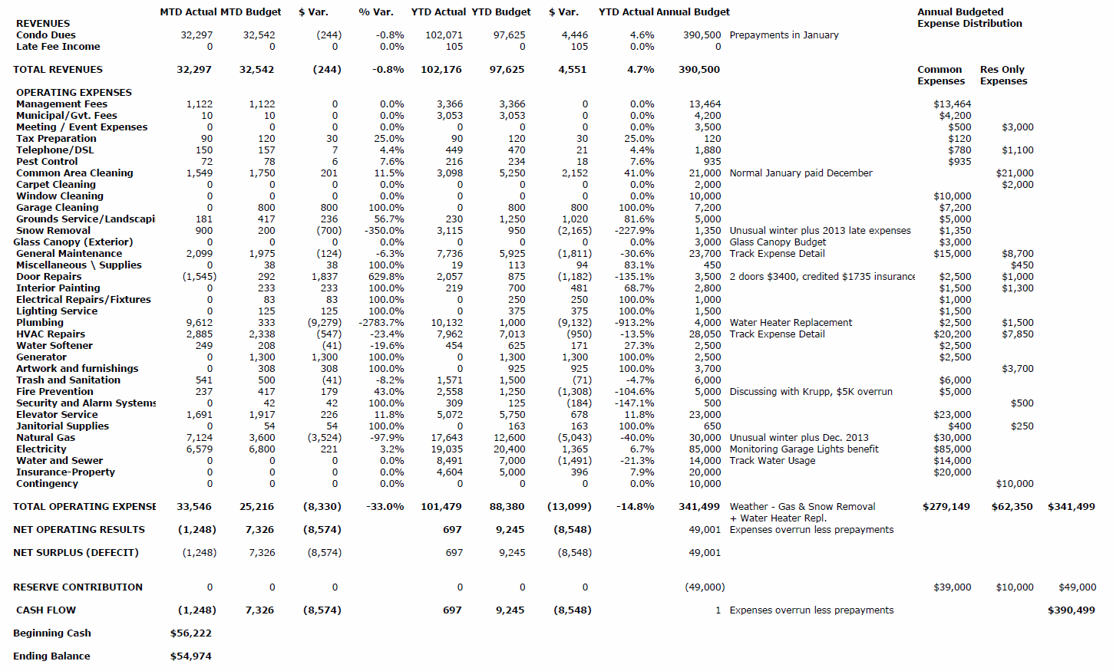
Example of Operating Expenses

